Slide 1
Server SIDE Programming
Sofyan Thayf

Slide 2
http://sofyanthayf.com
Web Server
Web Client
Web Browser
http://sofyanthayf.com
file.html
Script
Program
Interpreter
file.html
Interpreter
Data HTML
Client-side program
Server-side program

Slide 3
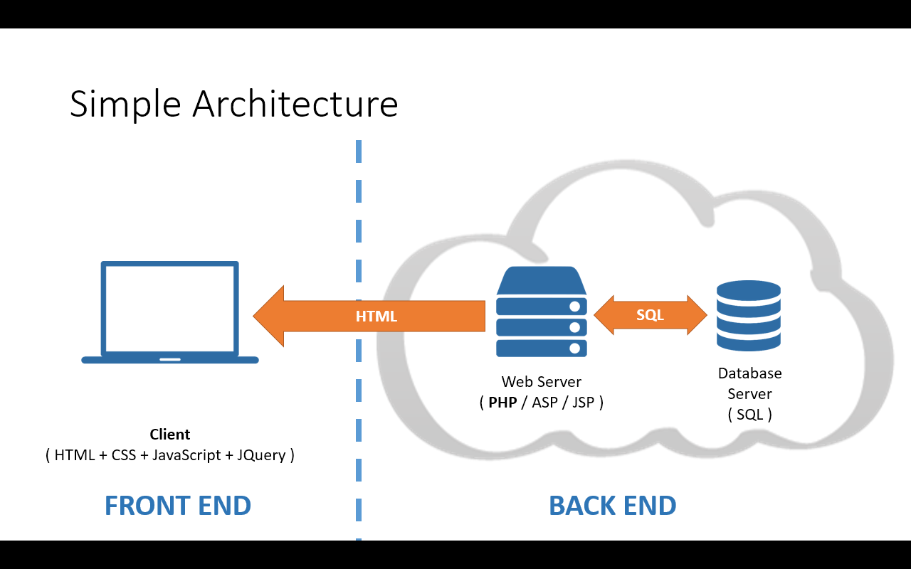

Slide 4
Server side
Web Browser | Web Server
Script program disimpan di server
Script program dieksekusi di sisi server
Hasil eksekusi dikirim ke Browser client
URL request
Listen
Parsing
Response
Interpreting
Display

Slide 5
Plus Minus
Plus
Minus
Eksekusi cepat
Akses ke database
Realtime
Tidak bergantung pada browser
Aman
Membebani server
Bergantung pada koneksi

Slide 6
